Slide 1
GPRS
General Packet Radio Service

Slide 2
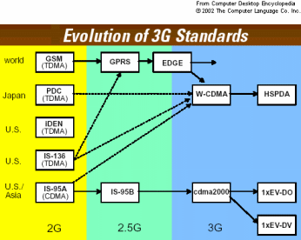
Evolution 2G , 2.5G and 3G

Slide 3
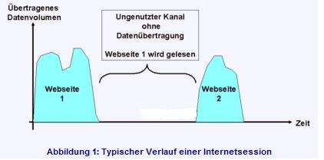
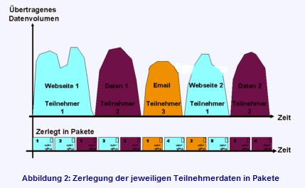
GPRS
Tốc độ truy nhập
Không truy nhập
t
Tốc độ truy nhập
t
t

Slide 4
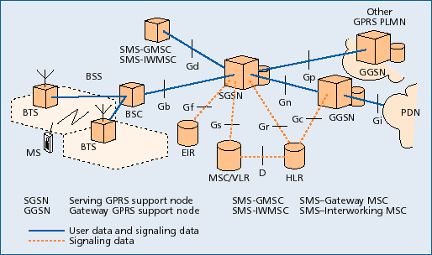
GPRS System Architecture
PDN - Public Data Network

Slide 5
GPRS Acronyms
SGSN – Serving GPRS Supporting Node
GGSN – Gateway GPRS Supporting Node
CGF – Charging Gateway Functionality
HLR – Home Location Register
PDN – Packet Data Network
PLMN – Public Land Mobile Network
Gateway GSN = packet switch interworks with other networks
Serving GPRS support node = packet switch with mobility management capabilities
GPRS makes use of existing GSM base stations

Slide 6
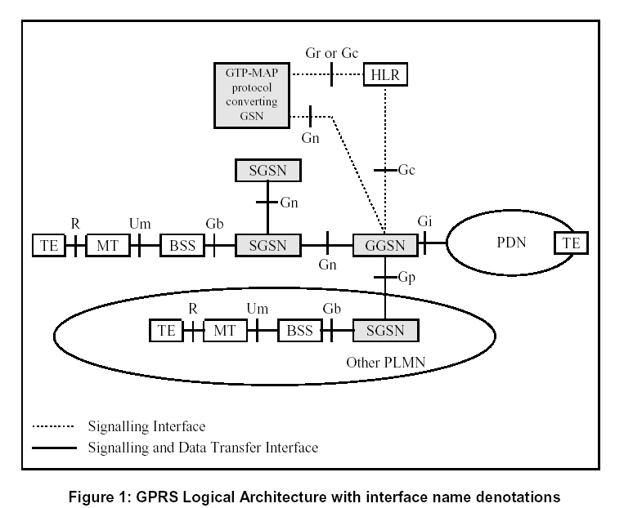
GPRS Logical Architecture
(GSM 09.60 version 7.4.0 Release 1998)
Notes:
Powering the Service-Driven Business
MT – Mobile Termination
TE – Terminal Equipment

Slide 7
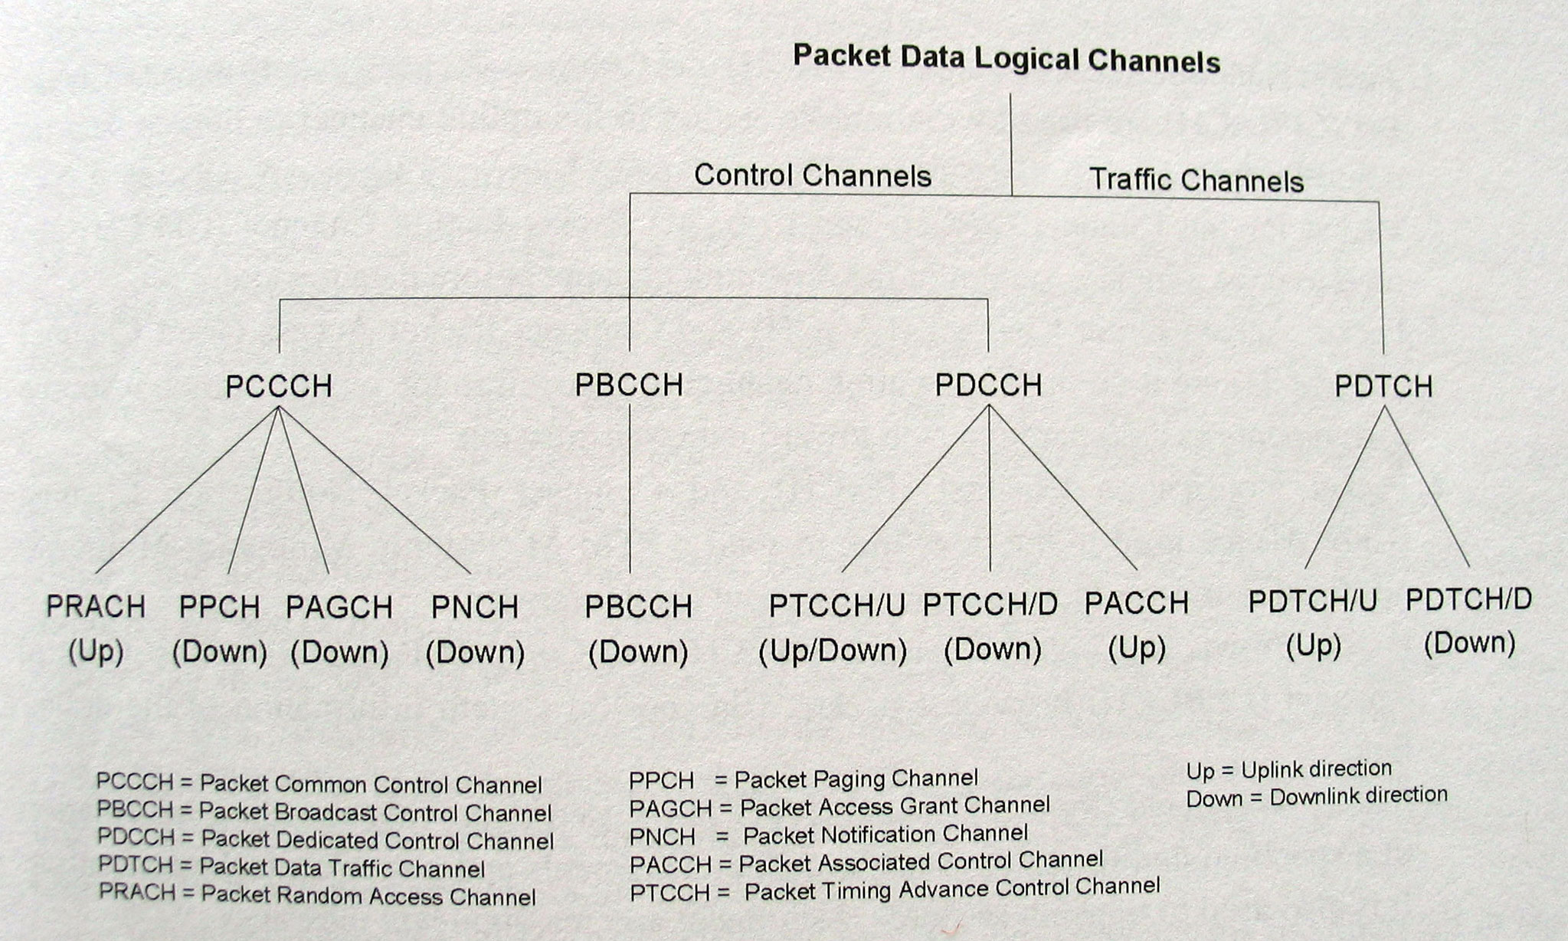
Logical Channels

